Slide 1

CRUD based Blog web application (“BlogScript”)
Summer Internship Report Presentation
Date: 08/11/2025
BCASI23501
Degree: BCA
Team Members
Pankaj Kumar Das
Rahul Kumar Senuhar
Banty Mishra
Course: BCA (5th Sem)
Project Guide:
Mr. Nitin Kumar Saini
&
Ms. Vartika Gupta
COLLEGE OF COMPUTING SCIENCE & INFORMATION TECHNOLOGY
TEERTHANKER MAHAVEER UNIVERSITY, MORADABAD

Slide 2

Team Details
Name | Enrollment | Role
RAHUL KUMAR SENUHAR | TCA2301558 | Frontend Developer
PANKAJ KUMAR DAS | TCA2301489 | Backend Developer Testing & Debugging Hosting & Deployment
Banty Mishra | TCA2301154 | Content Writer / Manage Pending Blogs
2

Slide 3
Table of Contents
Project Brief Introduction
Methodologies/ Technologies/ Tools to be used
Internship Duties
Context Diagram (Overall Project)
ER Diagrams
Challenges Encountered
Advantage of The Project
Summary and Conclusion
Appendices
3

Slide 4
1. Project Brief
During this internship, I worked on a live project named “BlogScript”, it is basically a CRUD based blog web application where a user can read and write text based blogs and also become a creator . Through this project, I not only learned about coding standards but also improved my problem-solving ability and development skills .
4

Slide 5



2. Methodologies/ Technologies/ Tools to be used
During my internship, I gained valuable skills that strengthened my career foundation:
Technical Skills:
  PHP for server-side scripting
  MySQL database management
  JavaScript for form validation and interactivity
  HTML & CSS for responsive UI design
  Git for version control and Infinity free Hosting
Professional Skills:
  Working in a tech environment
  Time management while handling project deadlines
  Problem-solving and debugging techniques
  Communicating effectively with supervisors and peers
5

Slide 6
3.Internship Duties:
Throughout my internship, I was actively involved in both development and testing phases of the BlogScript project. My major responsibilities included:
Week 1: Setting Up development Environment
Week 2: Developing dynamic web pages in PHP to enable basic CRUD (Create, Read, Update, Delete) application.
Week 3: Advanced Features Implementation
Week 4: Security Enhancements
Week 5: Testing the application for bugs, debugging code, and ensuring performance optimization.
Week 6 : Hosting in infinity free hosting
These tasks gave me the confidence to handle full-stack development modules independently.
6

Slide 7
rear
4. Context Diagram (Overall Project)
Posts
Creator
Dashboard
Creator Database
User
CRUD post
Creator ID
Signup & Login
Creator
Post Database
Post ID
7

Slide 8
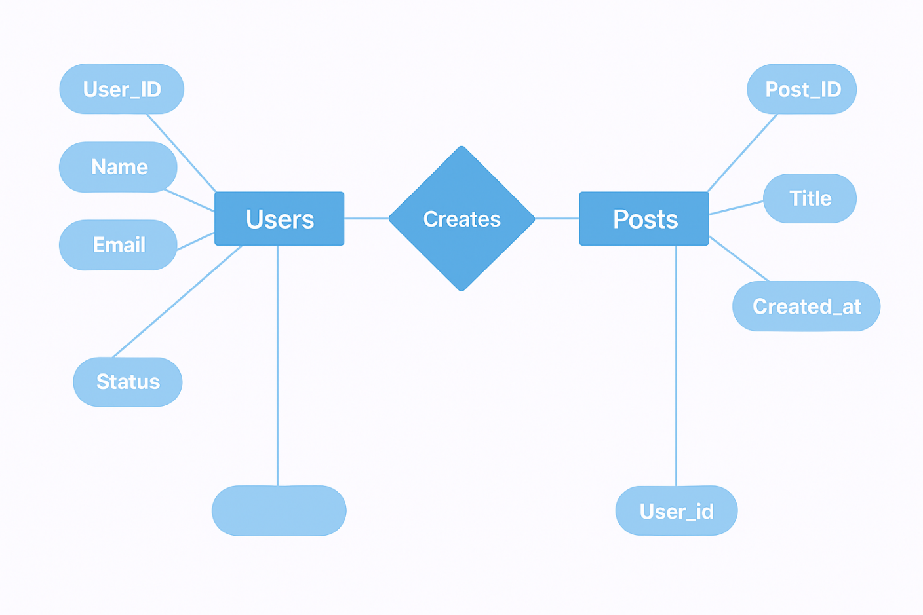
rear
5. ER Diagrams
8

Slide 9
6.Challenges Encountered:
Challenges | Solution
Handling complex database relationships | Learned normalization techniques and optimized queries for performance
Debugging authentication issues | Referred to PHP session handling concepts and used step-by-step debugging
Adapting to company’s coding standards | Studied their coding guidelines and followed structured documentation practices
Managing time between tasks and deadlines | Prepared daily task lists and followed Agile-based work tracking
9

Slide 10
7. Advantage of The Project
Easy Content Creation – Users can quickly write and publish blogs.
Update Anytime – Existing posts can be edited to keep content fresh.
Delete When Needed – Unwanted blogs can be removed in just one click.
User-Friendly Design – Simple interface makes it easy for anyone to use.
Responsive Layout – Works smoothly across desktop, tablet, and mobile.
10

Slide 11
8.Summary and Conclusion
BlogScript is a lightweight and efficient web application built on the CRUD (Create, Read, Update, Delete) model, giving users full control over their blogs. With a simple and responsive interface, it allows writers to:
Create new blog posts with ease
Read and explore articles through clean navigation
Update existing content anytime
Delete posts when no longer needed
Designed with scalability and SEO in mind, BlogScript is ideal for students, developers, and content creators who want a hands-on blogging experience while learning core web development concepts.
11

Slide 12
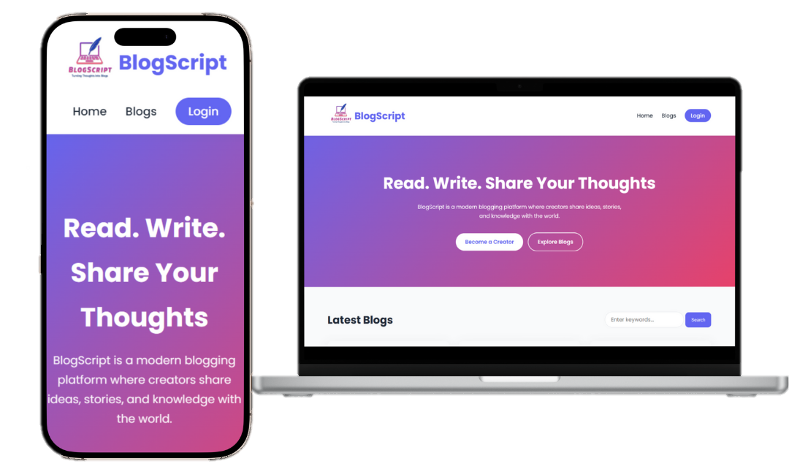
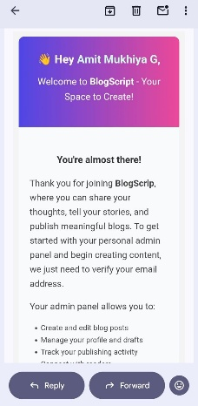
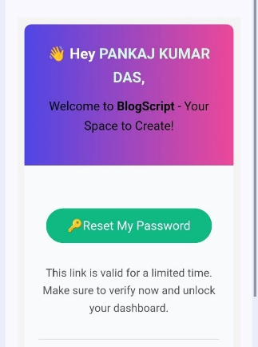
\
9. Appendices
12

Slide 13

10. Preview
https://blogscriptapp.free.nf/
13

Slide 14


